Slide 1
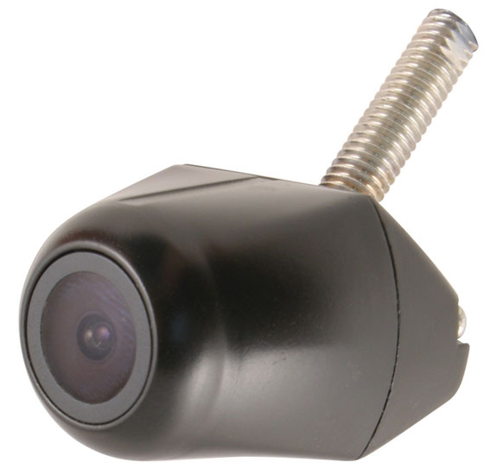
BE-500XC Series
Elite Version

Slide 2
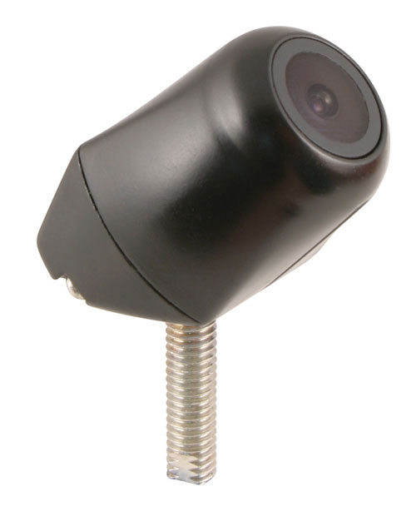
BE 500XC Series Features
1/4” Sharp CCD and Sharp DSP
Auto White Balance
Back Light Compensation
2 Models
  Horizontal (Mirror/Normal)
  Vertical (Mirror/Normal)
Single Bolt mount
154° Viewing Angle
Notes:
No Microphone
No IR LED

Slide 3
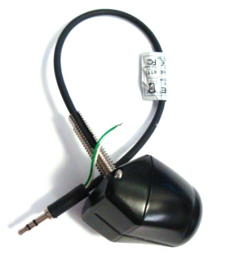
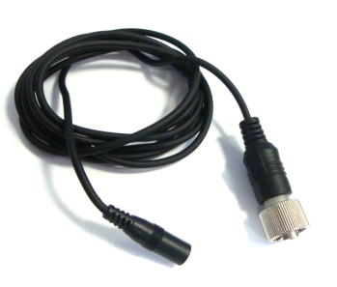
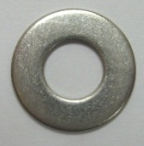
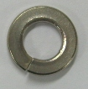
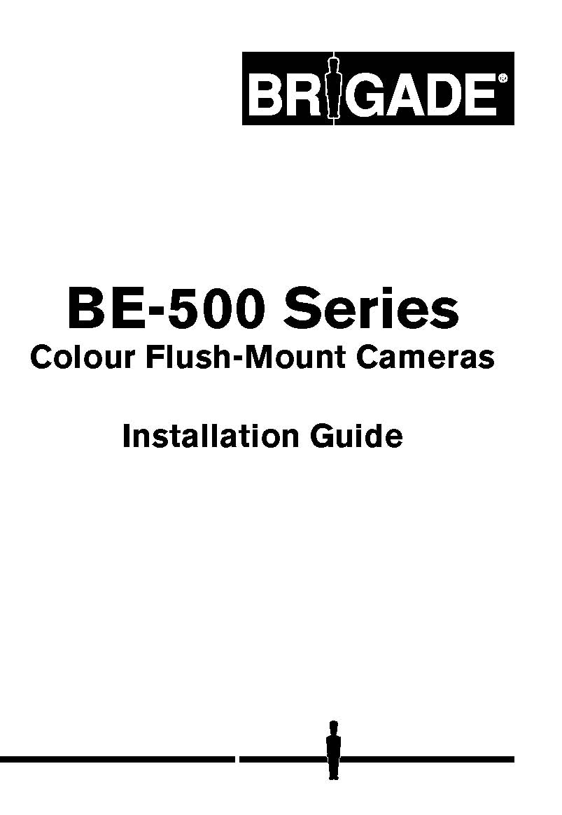
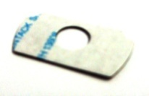
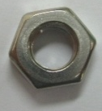
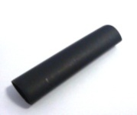
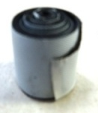
BE 500XC Components
1 x BE-500XC C – Camera Only
1 x BE-500XC CA – Cable Adapter
1 x BE-500XC Fix – Fixing Pack (6 parts)
1 x BE-500XC IG – Installation Guide

Slide 4
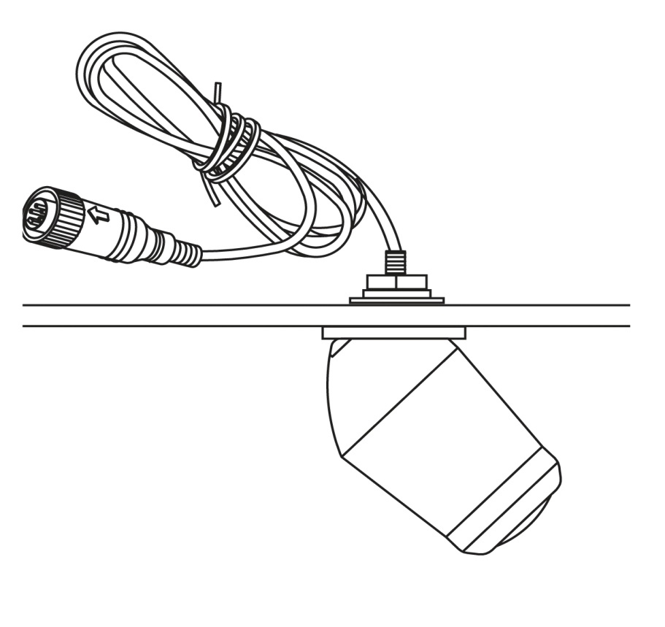
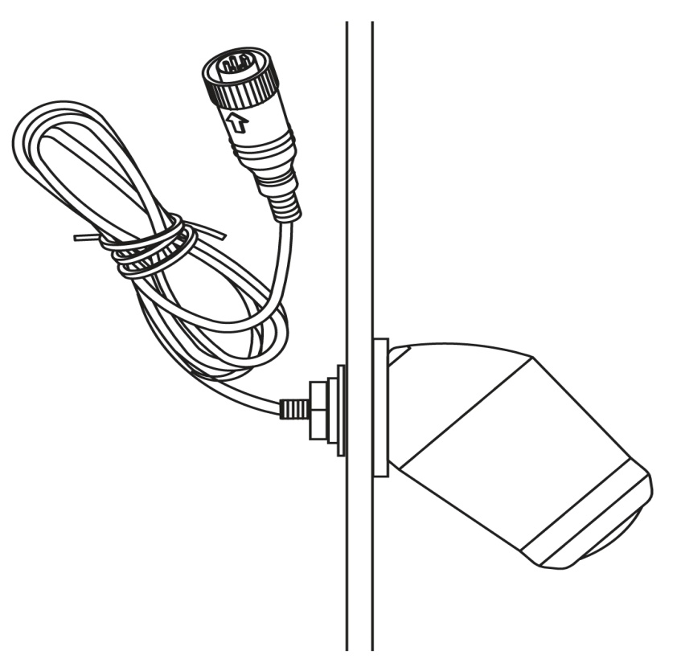
BE 500XC Installation
Horizontal Flush Mount
  BE-500HC
Vertical Flush Mount
  BE-500VC

Slide 5
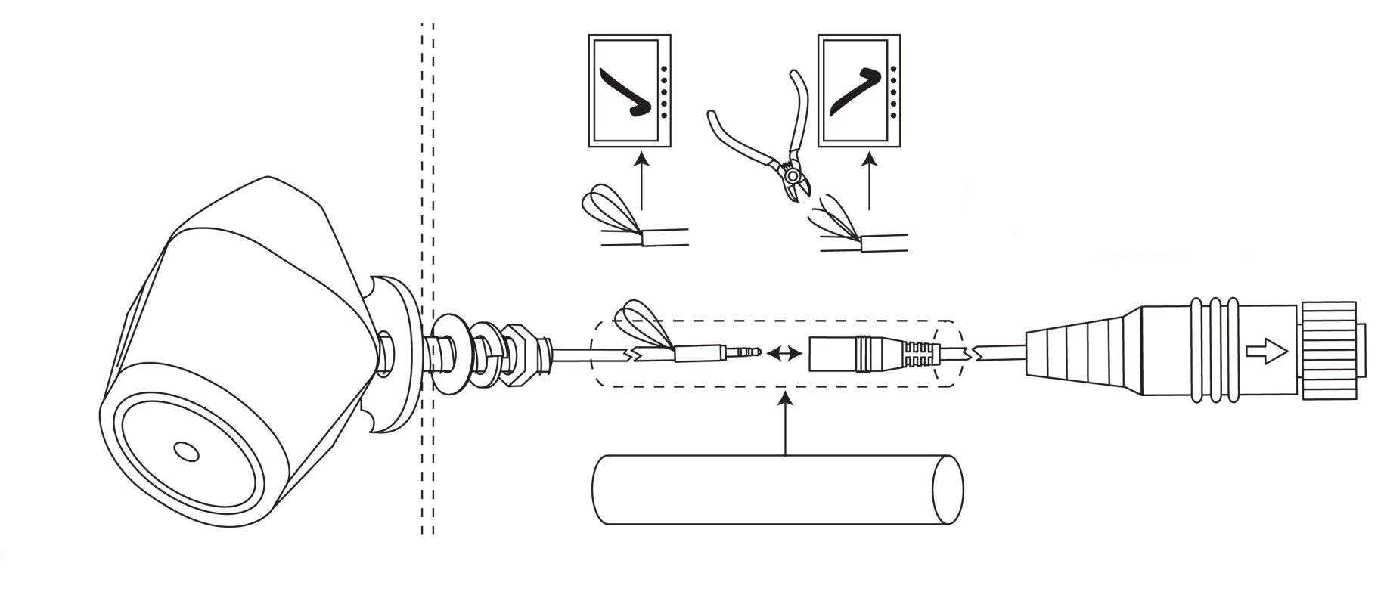
BE 500XC Connection

Slide 6
BE 500XC Specification
Operating Voltage: 12 Vdc
Imaging Devices: CCD - ¼” Sharp/DSP – Sharp
TV System: PAL
Picture Elements: 512 (H) x 582 (V)
Visual Resolution: 380 TV Lines
Required Illumination: 0.1 Lux
Viewing Angle: 122° (H), 94° (V), 154° (D)
Camera Housing: IP68
Operating Temperature: -25° to +80°C
Storage Temperature: -40° to +90°C
Vibration Rating: 10 G

Slide 7
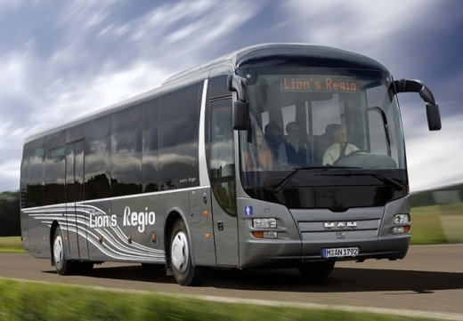

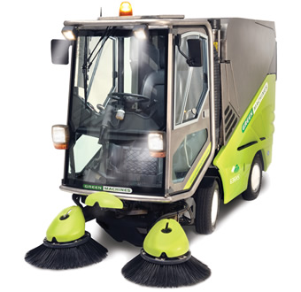

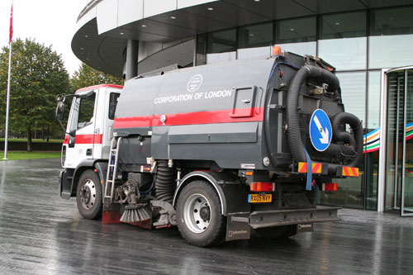
BE 500XC Application
Recreational Vehicles
Waste Management
Warehousing & Distribution
Passenger Carrying

